Slide 1
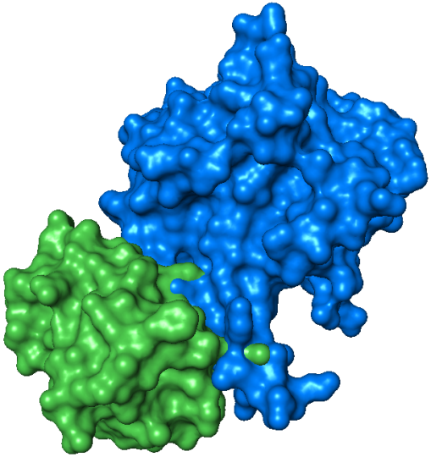
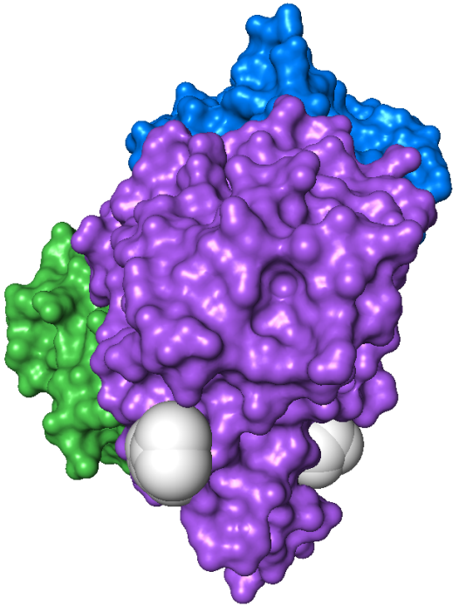
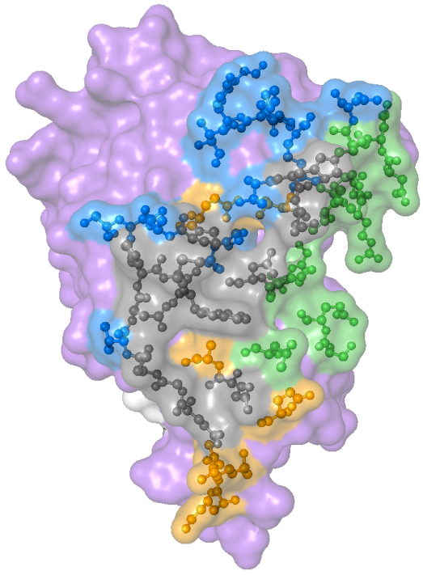
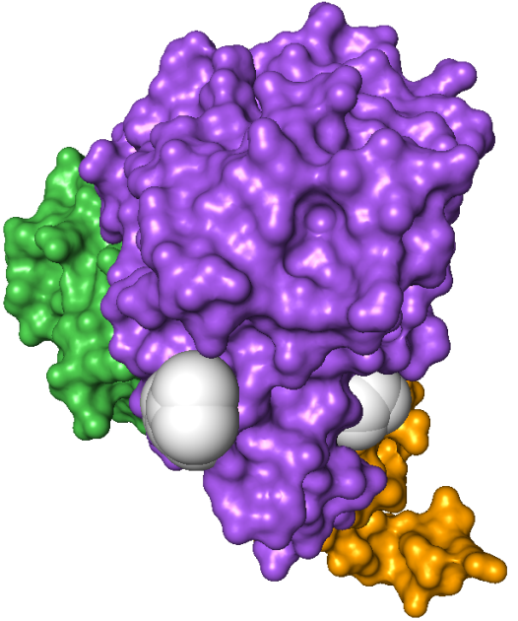
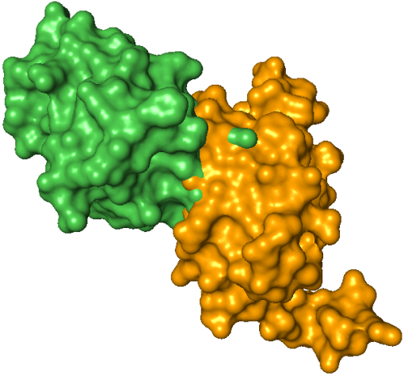
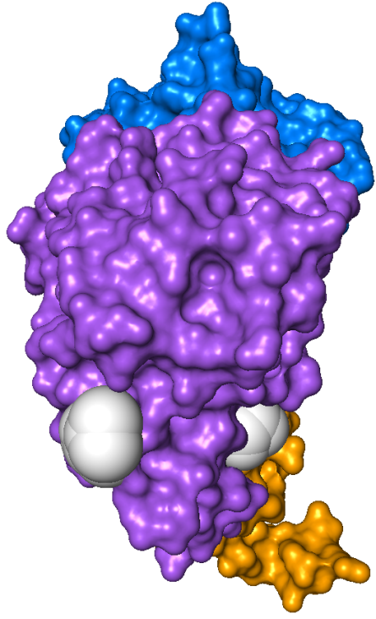
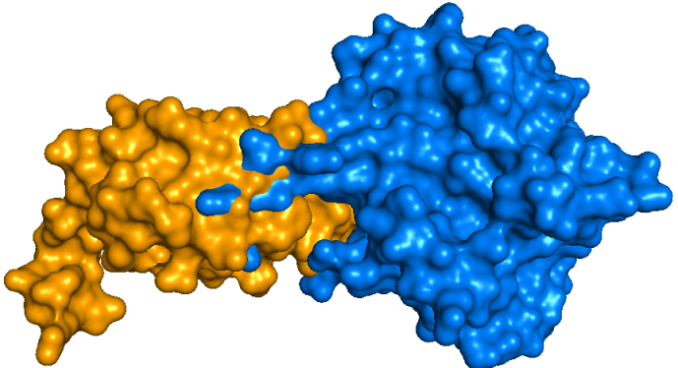
Core residues shared by Hpr, NanE, and U-PII
A
HPr
NanE
Binding interface shared by NanE and U-PII
Inter-subunit contacts
Inter-trimer contacts
C
N
NagB
Subunit interactions
B
M223
D165
N221
W224
W224
N
C
U-PII
C
Trimer interactions
X
NanE
U-PII
C

